Slide 1
r/place Analysis
Maddie Bomsta, Connie Chou, Melissa LaMette

Slide 2
Part 1: Data Preprocessing
For each csv file:
Change data type of “timestamp” variable into datetime format
Systematic sampling
Every 25th row, including the first row of each csv file
Maintain proportions of each csv file based on the timestamp
Roughly 50,000 rows
Concatenated all samples together into one
2,644,514 rows total

Slide 3
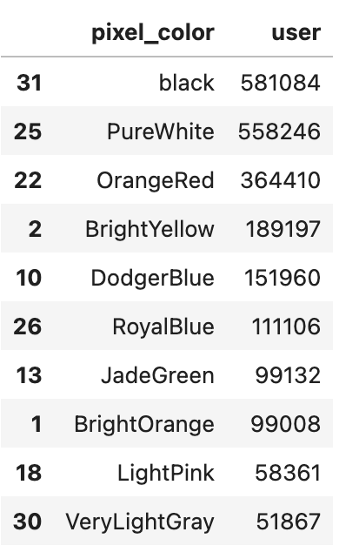
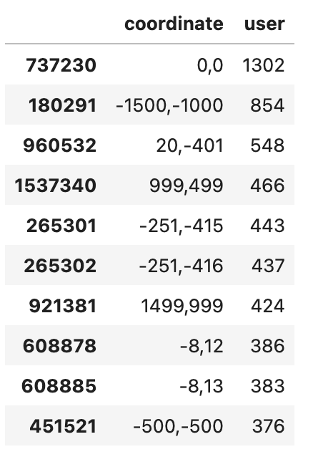
Part 2: Data Exploration
Most commonly used colors
Most commonly manipulated coordinate

Slide 4
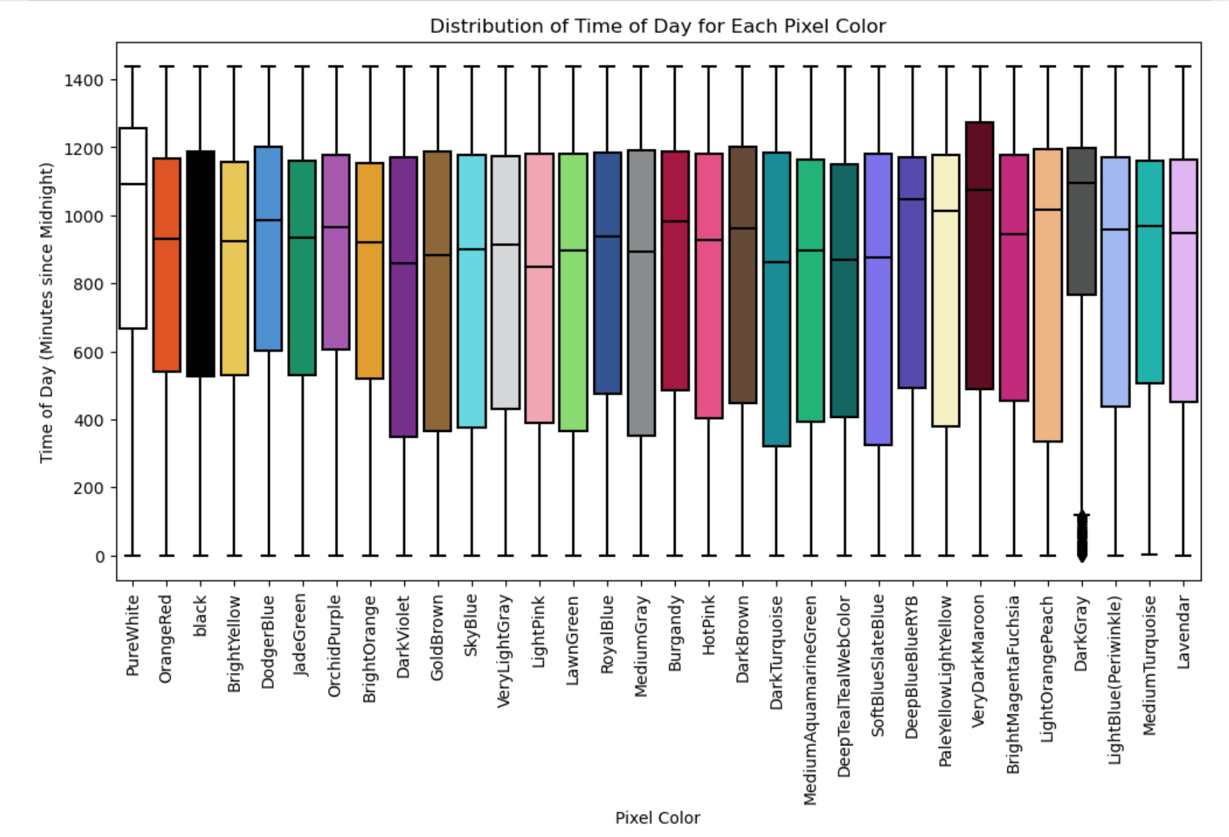

Slide 5
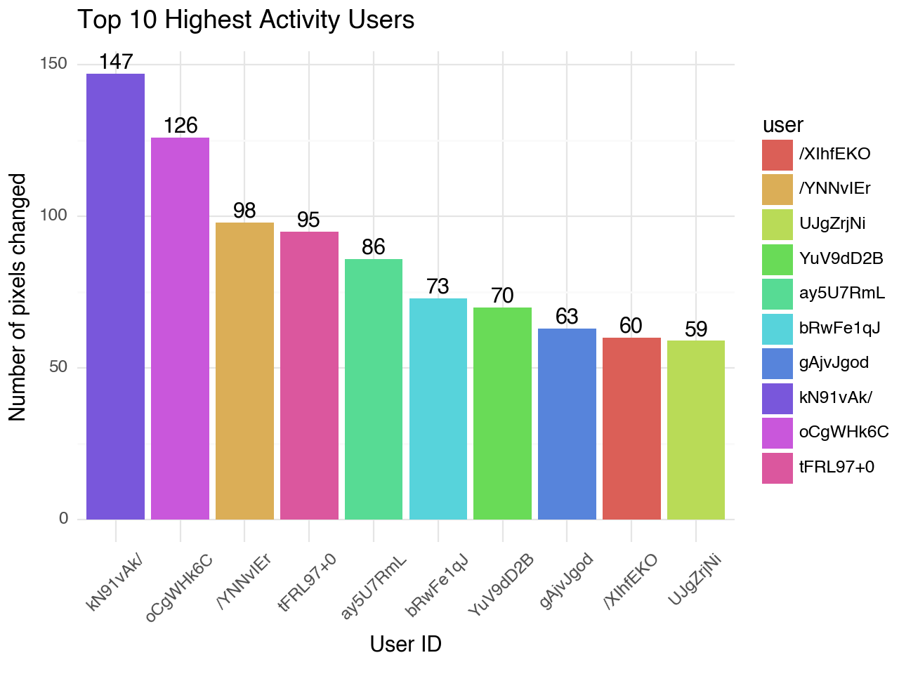
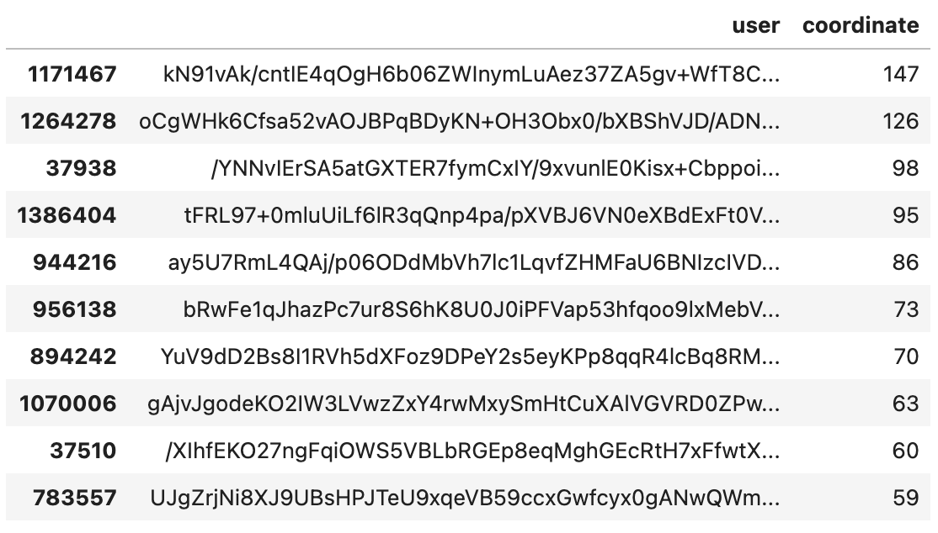
Part 2: Data Exploration

Slide 6
Part 3: The Issue with Bots
“Streamers using bot army should be banned too.”
“Either way it sucks. There should def be a certain amount of karma required.”
“Honestly, I’m done. I’ve participated in every r/place, but I refuse to continue to participate in events where my contribution is meaningless.”
“The event is made for people to participate on reddit. I totally feel you but it's the exact opposite of Reddit's goal”
“A coworker and I considered drawing a small figure in an obscure area but by the time we could lay a different pixel our first had changed a few times. Oh well.”

Slide 7
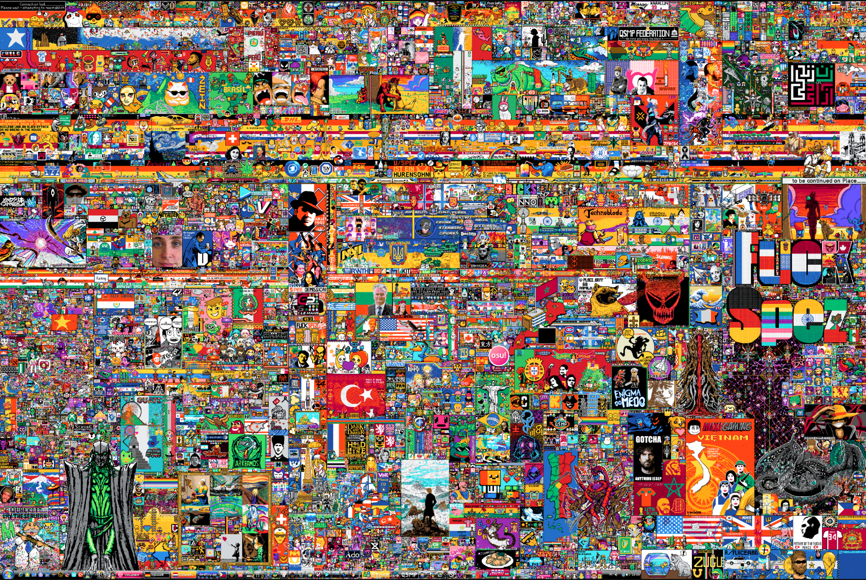
Methodology to Identify Bots
Our Hypotheses
Identify High Activity Areas
Analyze High Activity Users
Pattern Recognition
Timestamp Analysis

Slide 8
Our Hypotheses
Bot activity happens at scheduled times of the day, and they occur at a similar time range throughout the five days.
Bots place their colors in random pixels.
Bots place colors in pixels many times throughout the day.
These all correspond to the top 10 high activity users we have identified.

Slide 9
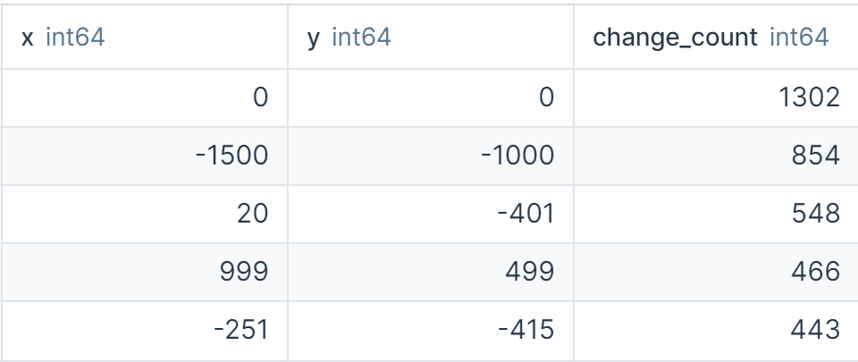
2. Identify High Activity Areas
Overall:
(0, 0), (20, -401), and (-251, -415), seem to be focal points of activity.
The distribution of changes across different coordinates indicates a wide area of engagement, suggesting that the activity was not limited to a small section of the canvas.

Slide 10
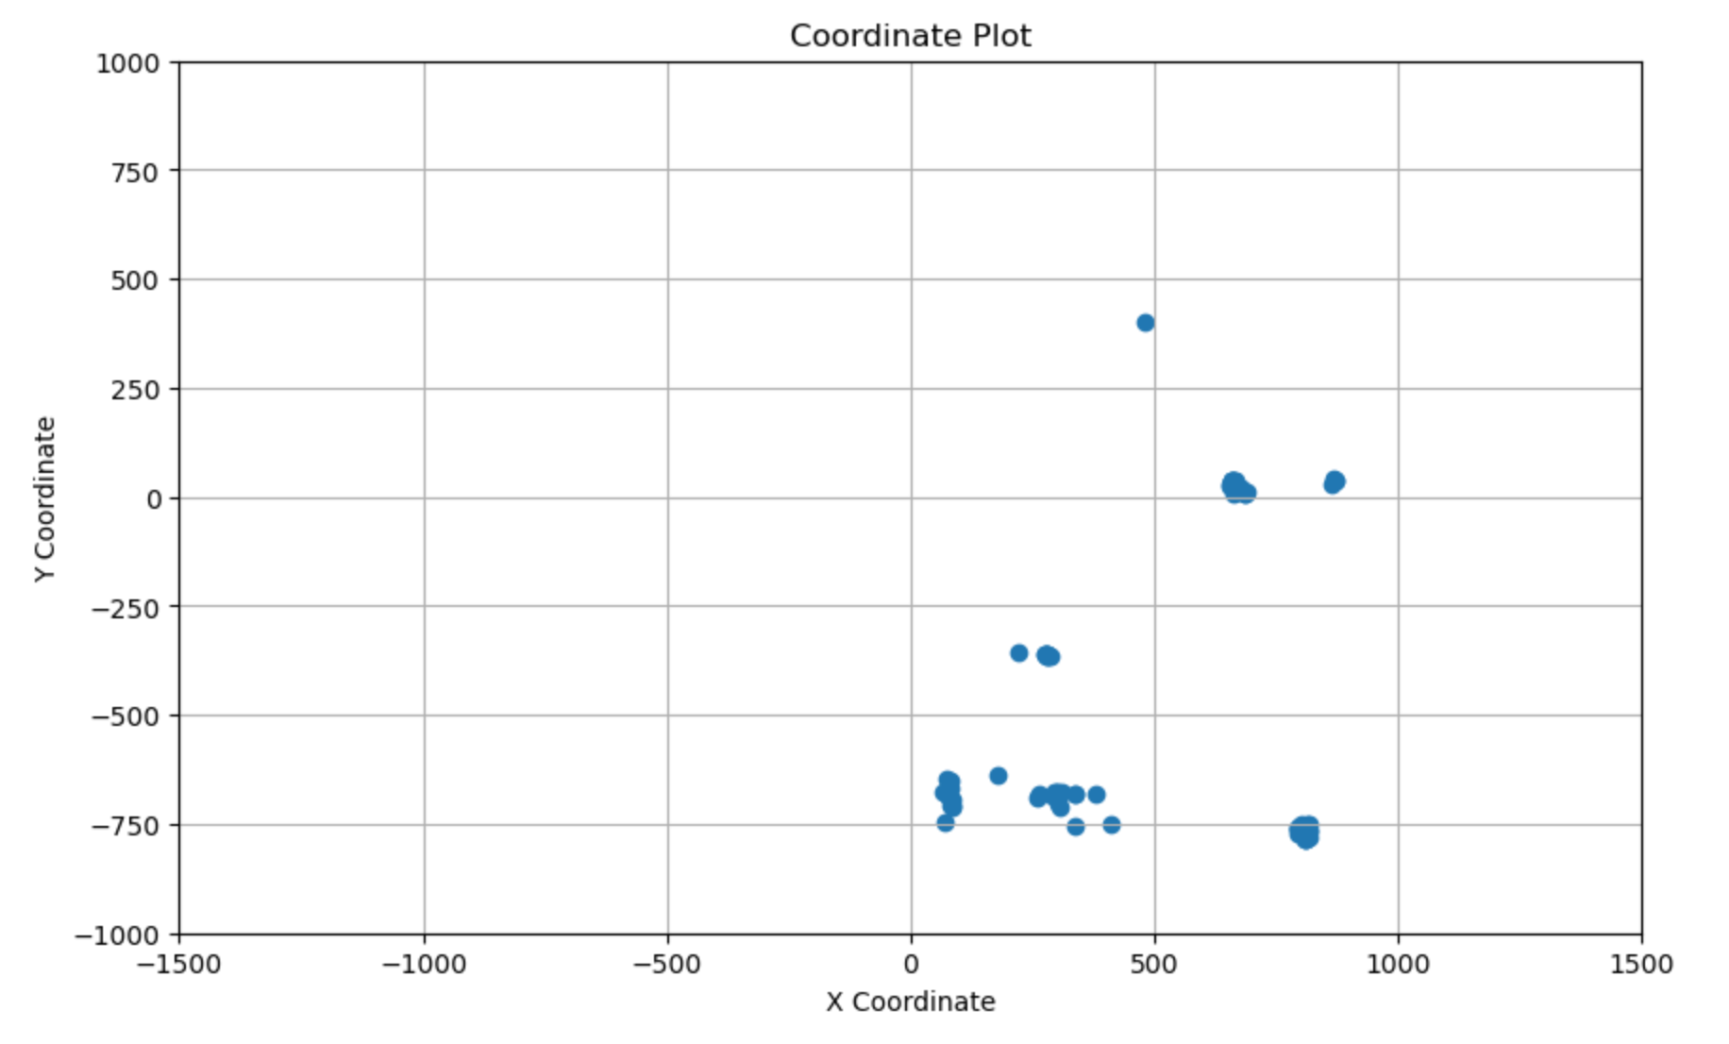

Slide 11
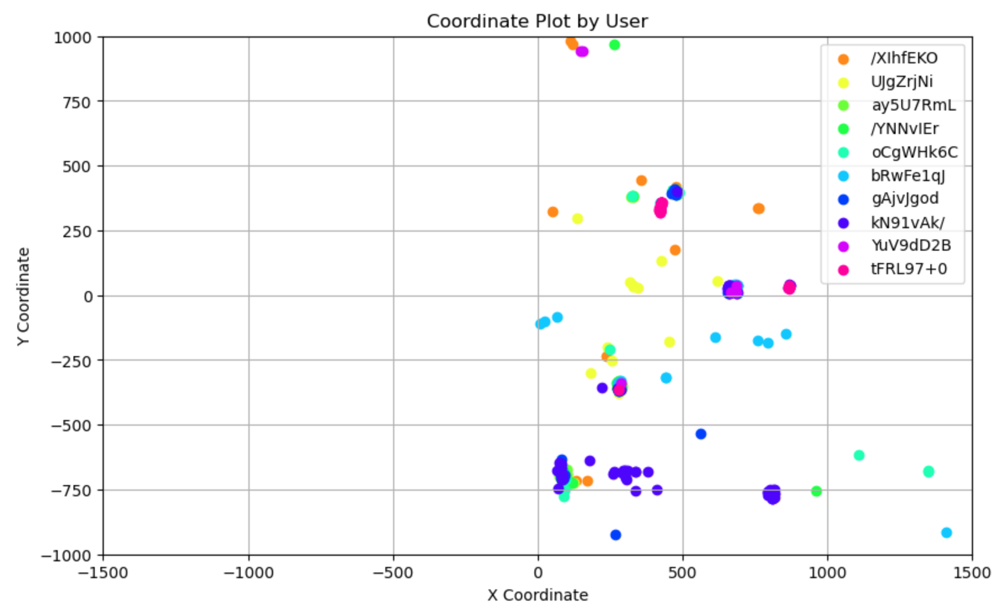

Slide 12
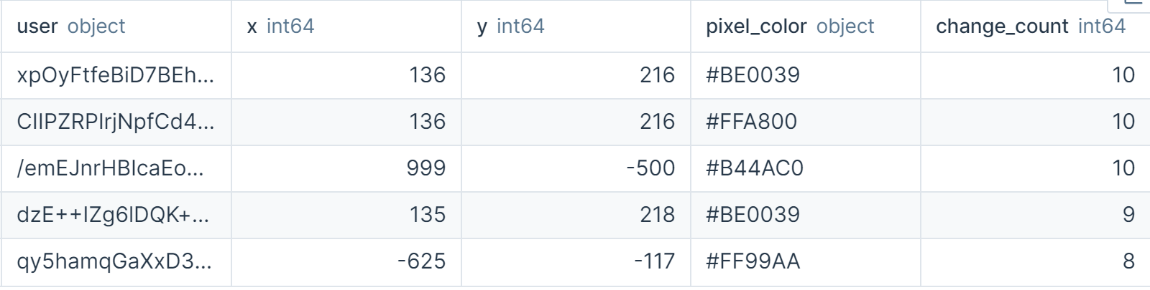
3. Analyze Specific Users
Of these users:
Some users appear to be collaborating or competing, as indicated by changes to similar coordinates (e.g., (136, 216)) by different users.
The high number of changes (8-10 times) at the same coordinates could imply automated or bot-driven behavior, especially if these changes occurred within a short time frame.

Slide 13
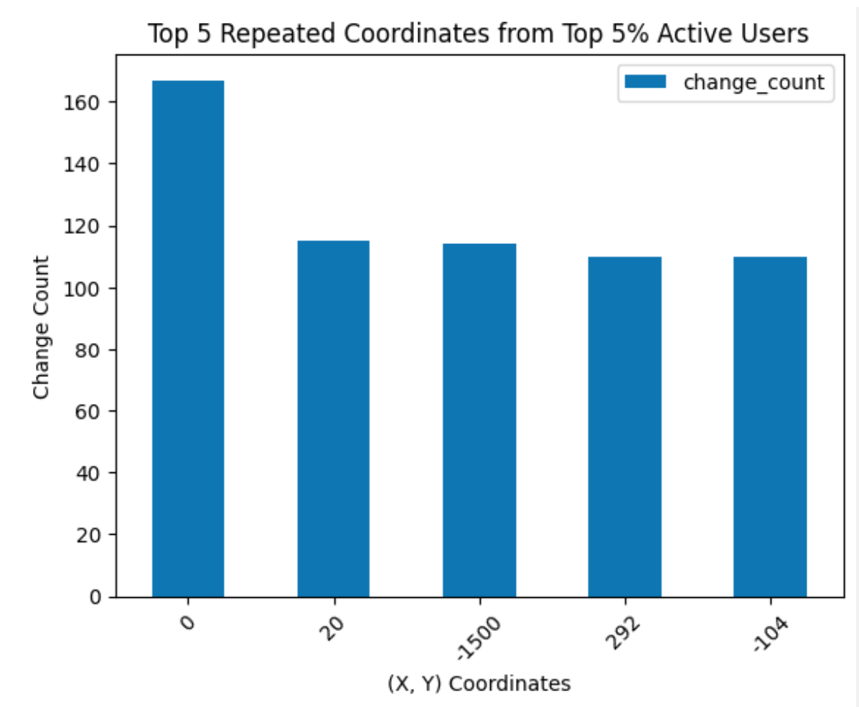
4. Pattern Recognition
Of these users:
The high frequency of changes at specific coordinates indicates concentrated activity in these areas.
The extreme repetition at certain coordinates (over 100 times) strongly implies automated processes or a concerted effort by multiple users to maintain or alter the appearance at these spots.
Notes:
Looking at the top 5% of users, these are the top 5 repeated coordinates from that group of users.

Slide 14
5. Timestamp Analysis
We looked at timestamps to see if there are specific time periods where bot activity peaked.

Slide 15
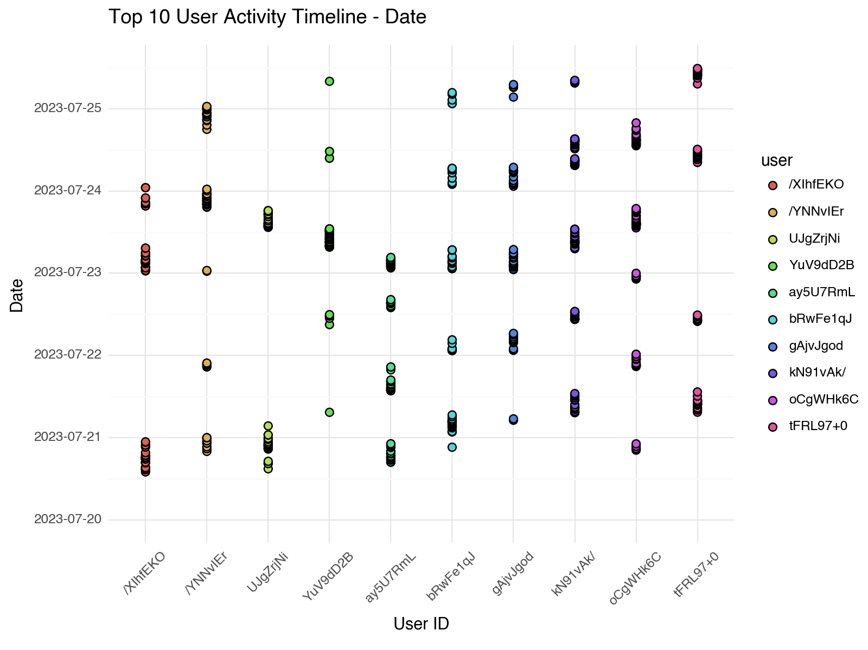

Slide 16
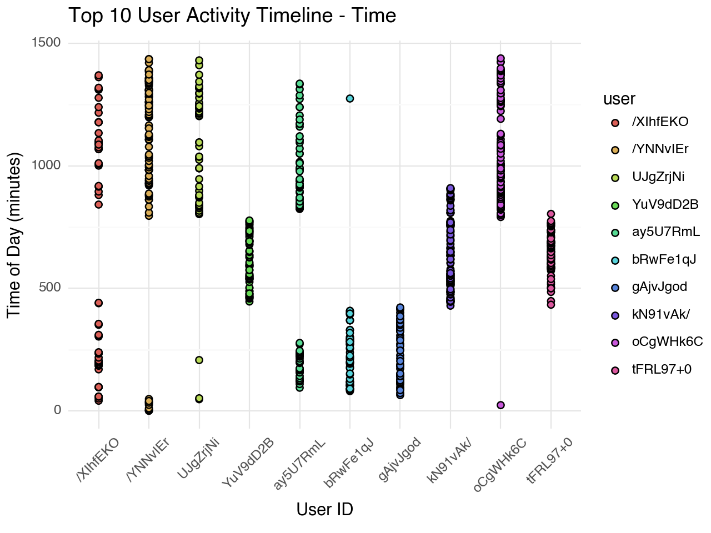

Slide 17
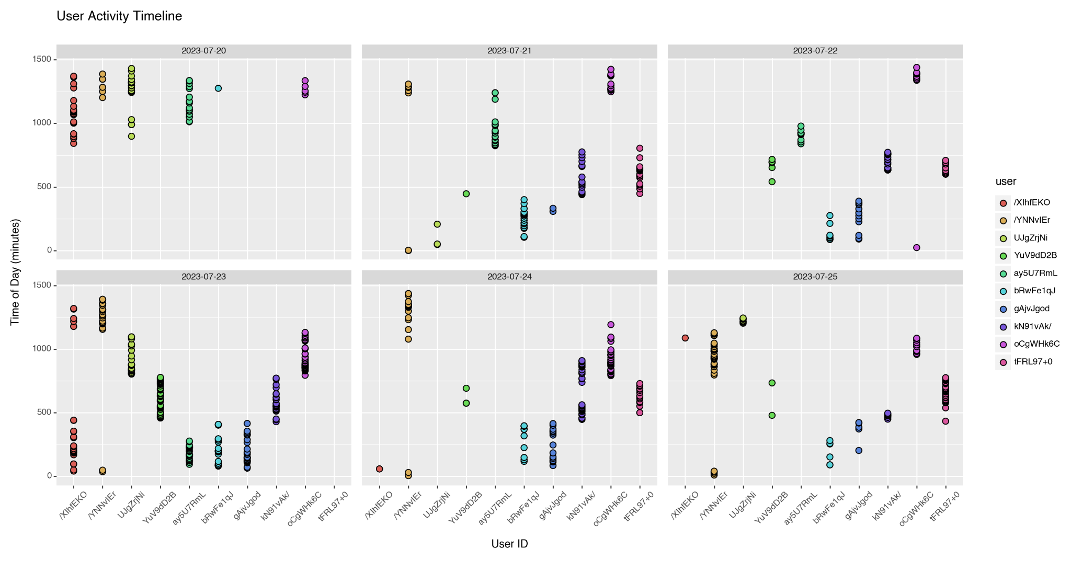

Slide 18
Let’s assume the average human is awake for 16 hours a day (8am - 12am).
If a user puts a color in a pixel every 10 minutes in a day:
16 hours = 960 minutes
960 minutes / 10 minutes = 96 times
96 times * 5 days = 480 times
This user would put a color in a pixel 480 times.
Is this possible? Yes, if the user has nothing better to do.
But it is unlikely.
* this is a sample

Slide 19
The Impact of Bots…
Conclusion:
Hypotheses
We plan to fail to reject that bot activity occurs on a schedule.
We plan to fail to reject that bots place colors at random locations.
We plan to fail to reject that bots place colors in pixels many times throughout the day.
We can speculate that 3 of the top 10 users are bots, but we cannot conclude.
Future Applications:
For the benefit of the users:
Reddit should regulate the use of bots to encourage users to participate without feeling overlooked or competing for usage.
For the benefit of Reddit:
Bots and competitive users are great because it brings high traffic and discussion as well as increased recognition to their site.

Slide 20
Thank You
Questions?

